Slide 1
Our UI Automation journey
Tom Austin
Lead Automation Engineer
Streets Heaver

Slide 2

Who am i?
Tom Austin
Blog at tomaustin.xyz
@tomaustin700
Work
Streets Heaver for 7 years
Started as Software Developer
Lead Automation Engineer for 2 years
Notes:
Started as Software Developer
Lead of the Automation Team – What do we do?
A lot of overlap with “DevOps” stuff
Build CI/CD pipelines
Write scripts to automate manual tasks
Write UI Automation for products

Slide 3
Ui automation?
Notes:
What do I mean when I say UI automation?
Tests which interact with the user interface like a user would such as entering data, clicking buttons and even testing processes end to end
To someone observing a test run it looks exactly like a user interacting with the system
Not recording mouse movements, each element on the screen is tagged with an id and we look for those ids
Mainly used for regression tests – tests which check that something that did work still works

Slide 4
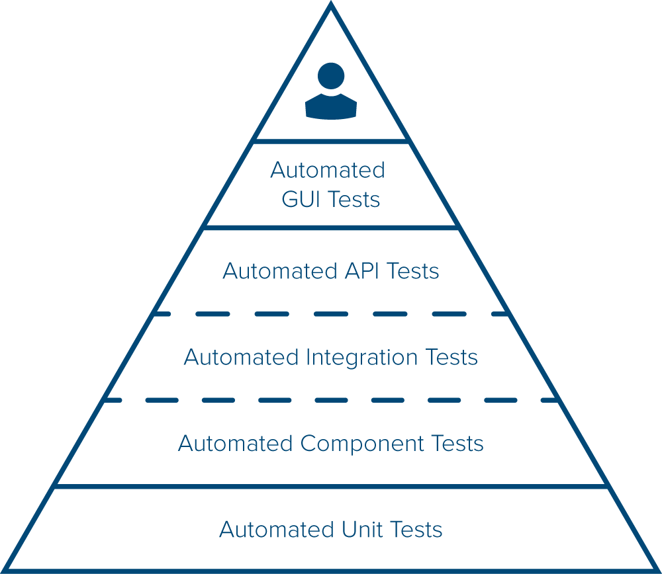
Notes:
We’re talking minutes to run instead of milliseconds like a unit test
Used to find regression issues and check the system functions as a whole

Slide 5
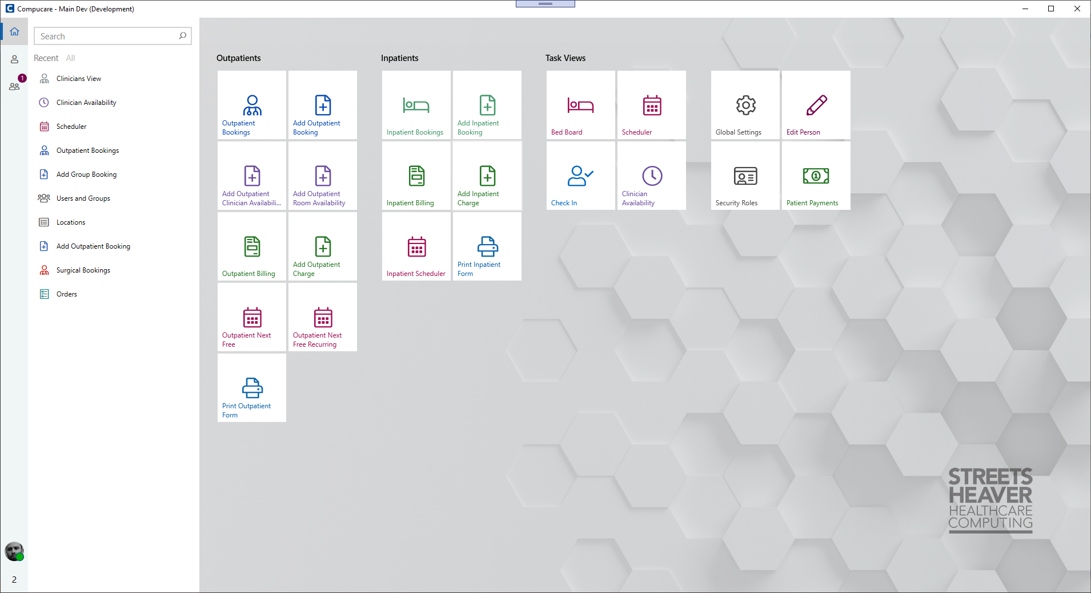
Compucare
Notes:
Compucare – Hospital administration and billing system
Written in WPF – C#/XAML
4 years of development before first client – an extra year before we considered it finished
140 Different screens – 300/400 different states
SQL Server backend – 369 tables
Used to have a lengthy manual walkthrough – replaced most of it with UI Tests

Slide 6
UI Automation Journey
Early days of Compucare all the testing was manual
Long (3 Month+) Release Cycle
Massive amount of regression testing at the end of each sprint
Notes:
Info about the walkthrough and amount of tests
Always finding issues so couldn’t get rid
So what do we have now?

Slide 7
UI Automation Journey
5000 UI Tests
All tests run nightly
6 Hour run time
1min 20sec average test run duration
QA now have time for exploratory/usability testing
Notes:
Info about our tests
Every screen and process tested
Every bug or user story completed has UI tests written for it
Works out to around 110 hours of non stop testing each night
We’ve saved QA multiple weeks of regression testing per sprint

Slide 8
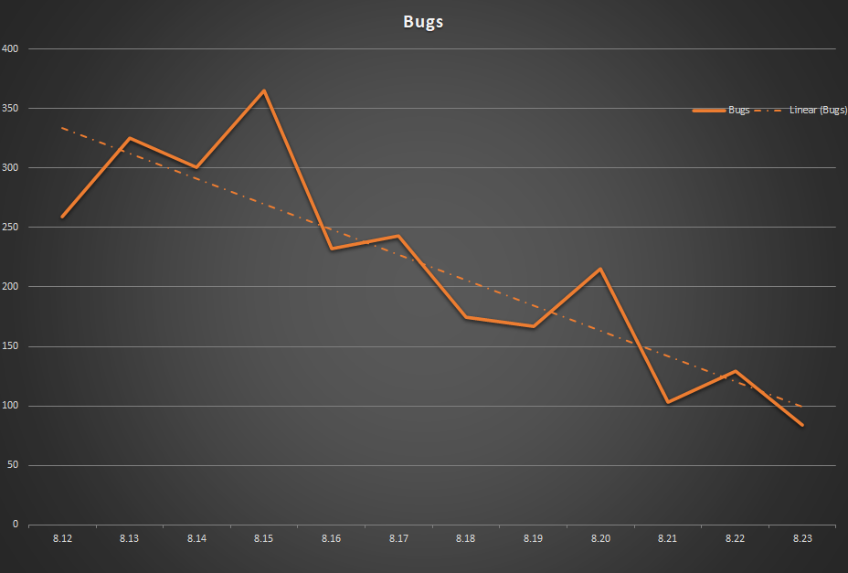
Notes:
Since introducing automated UI testing the amount of bugs found has dropped significantly
This graph shows bugs found per sprint for the last 11 sprints
We are now a few sprints on from this so in theory even less bugs will have been found

Slide 9
My opinion on UI Testing?
Notes:
If you’re not careful you can end up with something like this…

Slide 10
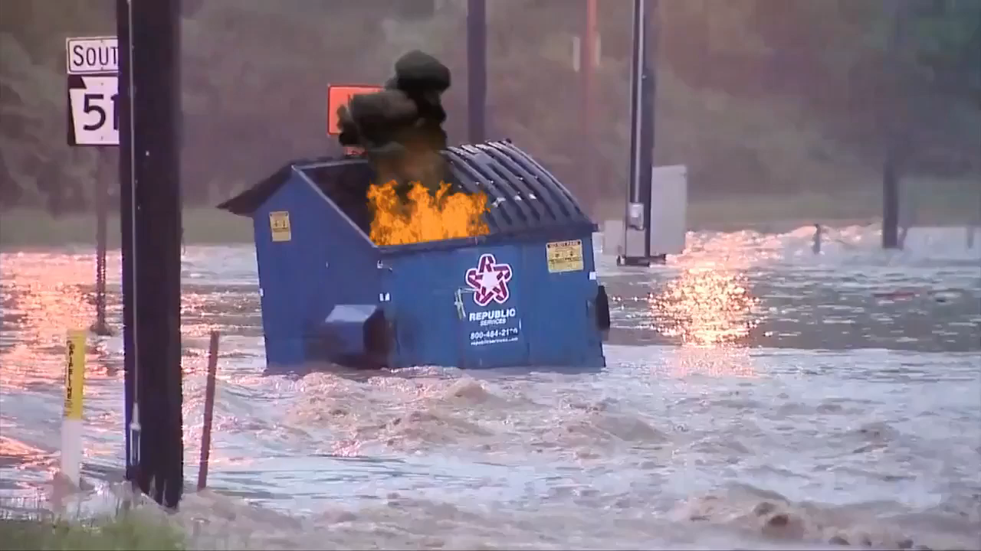
Notes:
I think this says it all

Slide 11
It doesn’t have to be that way
Notes:
but

Slide 12
Problems?
Notes:
What problems did we encounter?

Slide 13
Problems?
Not many doing WPF UI automation
Notes:
From what we found not many people are doing WPF UI Automation, everyone is doing web automation

Slide 14
Problems?
Tests too complicated to write
Notes:
At the beginning the tests were very complex to write and not very user friendly – hard to understand exactly what the tests were doing by looking at the code
Waiting for elements to exist and that they are ready to be interacted with seemed like a dark art

Slide 15
Problems?
Slow to run
Notes:
Once we got over a few hundred tests they were taking many hours to run – at one point we had about 900 tests that were taking longer than 24 hours to execute
Long test runs were not workable and were not providing feedback as we were having to wait too long to get the results so we needed to make something that was scalable

Slide 16
Problems?
Flaky tests
Notes:
Flaky tests are a huge problem with UI automation, it’s usually the way the tests were written and not the tools but sometimes unexpected things happen – the more complex the test the more flakiness was introduced
Flakiness makes us lose confidence in the tests and if we don’t have confidence we might as well not have them
We will get onto these a bit more later

Slide 17
Problems?
Difficult to analyse failures
Notes:
When things do go wrong (which they will) it was hard to know what had happened, we were spending a lot of time investigating “false positives” instead of writing new tests
So how did we tackle these issues?

Slide 18
Our testing stack
Based on FLAUI github.com/FlaUI/FlaUI
Microsoft UIA Automation
C#
MSTest
Azure DevOps
Fluent Assertions
Notes:
Starting with making sure we had a stack that was going to work for us and this is what we ended up with
Nearly every product I’m going to mention throughout this presentation use is open source – not because it’s free but because they are the right tool for the job

Slide 19
Our testing stack
Based on FLAUI github.com/FlaUI/FlaUI
Microsoft UIA Automation
C#
MSTest
Azure DevOps
Fluent Assertions
Notes:
Talk through how we decided on FLAUI
Microsoft CodedUI seemed promising but produced questionable code – now been depreciated – says it all
Couldn’t get Appium working reliably on all dev machines
A few others such as TestComplete and Ranorex – use a GUI and didn’t have the capabilities to do what we wanted
Settled on FLAUI – “flowie?” - We still don’t know how to pronounce it
Seemed the most popular
It was opensource so we could see how it worked – proved invaluable but will get into that a bit more later
Written in C# which we were all familiar with – I had 5 years experience before we even started which allowed us to get up and running a lot quicker

Slide 20
Our testing stack
Based on FLAUI github.com/FlaUI/FlaUI
Microsoft UIA Automation
C#
MSTest
Azure DevOps
Fluent Assertions
Notes:
Talk about fluent assertions

Slide 21
Our testing stack
Based on FLAUI github.com/FlaUI/FlaUI
Microsoft UIA Automation
C#
MSTest
Azure DevOps
Fluent Assertions
Notes:
We use MSTest for test execution as it just works – plug and play with Azure DevOps
Use Azure DevOps pipelines to run the tests – if you’ve never checked out Azure DevOps then I recommend you do, we use nearly every feature and it works very well for us
It’s completely free if you have open source projects and if not still quite reasonable

Slide 22

Writing UI tests is hard
Notes:
I think we’ve all felt like this at some point
When writing UI tests you feel like this all the time
Every time you interact with the UI it will react slightly differently such as the speed a screen opens or the time it takes to save a record
With WPF applications the application startup time isn’t even consistent, so you have to deal with that
Test code needs to be able to deal with this and not just crash and burn
If you’re not careful the test logic starts becoming very complex which then results in flakiness
We wanted UI tests to be something anyone could write regardless of their level
Let’s talk about things to avoid…

Slide 23
Things to avoid
THREAD.sleep ❌
Spinwait✔
Notes:
Never use thread.sleep – waits a set amount of time before moving on
End up making it sleep for much longer than required to work around the UI which then increases test run time
We used SpinWait instead which waits for a condition to be met before moving on

Slide 24
Things to avoid
If/else ❌
Test per condition✔
Notes:
Never have if/else statements within tests, the test should know exactly what it should be doing and the UI should be in a state that the test is expecting
If you aren’t confident what state the UI should be in then you’re asking for flaky tests

Slide 25
Things to avoid
Auto generated ids ❌
Manually set all ids✔
Notes:
Sometimes UI code will auto generate automation ids for you – DON’T USE THESE and DON’T TRUST THESE –they might change.

Slide 26
Things to avoid
Nonstandard code❌
Base class common methods✔
Notes:
If your tests are doing something complex then move that code somewhere where all tests can access it, if you don’t do this people will do things differently and you’ll end up with a mess
Standardizing everything becomes a nightmare

Slide 27
Things to avoid
Nothing strongly typed❌
Use constants✔
Notes:
What do I mean by strongly typed?
If someone renames something and they haven’t fixed it everywhere the code wont compile
Strongly type everything that you can – last thing you want is an automation ids changing but you don’t know where it’s been used and then your tests start failing

Slide 28
Things to avoid
Bad/no naming convention❌
Mandatory convention✔
Notes:
Have a naming convention for your tests – test names should accurately describe what they are doing – last thing you want is having multiple tests doing the same thing
How did we avoid these issues?

Slide 29
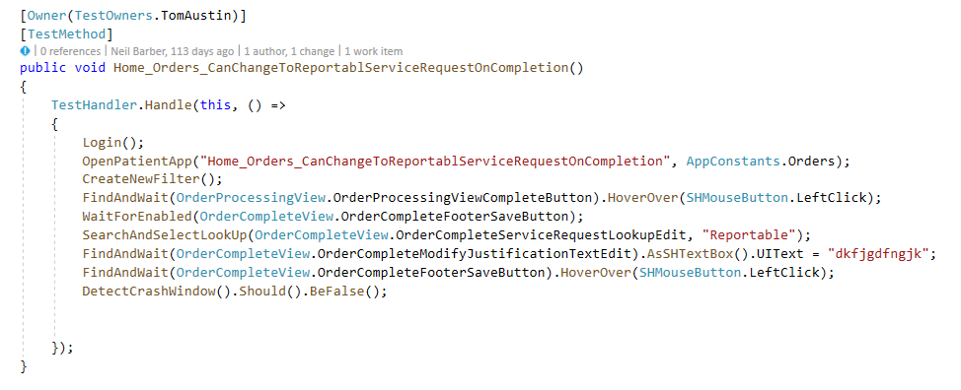
What did we end up with
Notes:
Test Owner so we know who wrote the test and if it fails Azure DevOps will auto create a task and assign it to the owner for investigation
Test name accurately describe what the test is doing
TestHandler deals with starting the application and waiting for it to be ready for to interact with the application
The data each test accesses is generally named the same as the test to make it easily identifiable
Let’s look at this test in action…

Slide 30
What did we end up with
Notes:
Test Owner so we know who wrote the test and if it fails Azure DevOps will auto create a task and assign it to the owner for investigation

Slide 31
What did we end up with
Notes:
Test name accurately describe what the test is doing

Slide 32
What did we end up with
Notes:
TestHandler deals with starting the application and waiting for it to be ready for to interact with the application

Slide 33
What did we end up with
Notes:
Login – Pretty straight forward

Slide 34
What did we end up with
Notes:
The data each test accesses is generally named the same as the test to make it easily identifiable

Slide 35
What did we end up with
Notes:
FindAndWait will find our ui element and wait for it to be ready to be interacted with

Slide 36
What did we end up with
Notes:
Fluent assertions to assert the values
Now that we’ve been through the code let’s look at a test actually running

Slide 37
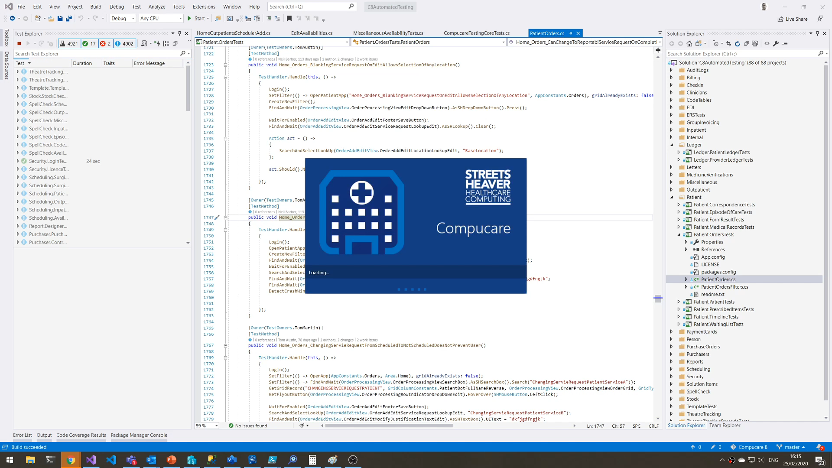
Notes:
So now we have tests written to a good standard what other problems did we face?

Slide 38

UI TESTS are slow
Notes:
We quickly learnt that UI tests are slow to run – REALLY SLOW

Slide 39
How do we run 5000 tests nightly?

Slide 40

Development Machine
Notes:
We started by running tests on our dev machines during lunchtimes – Quickly this started taking longer than an hour
We soon decided that wasn’t going to work

Slide 41
Development Machine
2 VM’s
Development Machine
2 VM’s
Development Machine
2 VM’s
Notes:
Then moved on to virtual machines on our dev machines using Hyper V
We thought we could get away with 2 vms per dedication machine
Worked well for a while
Started running into resourcing limit
At one point half of our system memory was being used by vm’s which isn’t ideal on development machines
We quickly realised we needed dedicated test infrastructure

Slide 42
Test infrastructure
Azure DevOps
Azure pipelines
Hashicorp packer
Microsoft
Hyper-V
Notes:
We knew we needed to get tests running in parallel as we were looking at runs taking weeks without it
First thing we did was look at building dedicated testing environments that could run tests with no manual intervention – needed tests runs to be able to be scheduled to run at night

Slide 43
Test infrastructure
Azure DevOps
Azure pipelines
Hashicorp packer
Microsoft
Hyper-V
Notes:
We use Packer to script our vitual machine images, has anyone used packer before?
Packer allows you to build automated virtual machine images from a config file, we use unattended.xml to install windows and then packer to install any software we need this then produces a hyper v hard disk
If we need a new piece of software on our virtual machines we update the packer config file and it creates us a hyper v hard disk automatically
Then have a powershell script that is basically an infrastructure as code file which picks up this hyper v hard disk creates as many identical virtual machines as we want – makes sure all our environments are identical

Slide 44
Test infrastructure
Azure DevOps
Azure pipelines
Hashicorp packer
Microsoft
Hyper-V
Notes:
We use Azure DevOps and Azure Pipelines to run the tests on these virtual machines.
Each area of our application is split into a different test project and we have a dedicated azure pipeline for each project – currently we have 87 projects/pipelines which run tests on 32 virtual machines
If we wanted the test run to complete quicker we can just add more virtual machines and register with Azure DevOps, no further config would be required

Slide 45

Hardware
X2
AMD Ryzen Threadripper 2970WX
64GB RAM
Two 1TB SSD’s (RAID0)
Notes:
We needed hardware with lots of threads and pretty high clockspeed – Compucare performs better with higher clockspeed and so does test execution
Intel Xeon was our first thought but we couldn’t get a lot of threads and a reasonable clockspeed for a reasonable price/performance ratio
Luckily for us AMD had just released their X399 Threadripper platform
2970WX has 24 cores/ 48 threads
Base clock of 3ghz and a boost clock up to 4.2 ghz
This platform was perfectly suited for being hypervisors for our virtual machines
Each hypervisor runs 16 virtual machines
We run in RAID0 for maximum IOPS as ui tests seem to be fairly iop sensitive
So what does our infrastructure look like?

Slide 46
Azure DevOps/Azure Pipelines
Agent Pool
Notes:
Each threadripper has 16 vms
All the vms are joined to an Azure DevOps agent pool
Azure Pipelines sends test runs to the pool and the run is randomly allocated to a virtual machine within the pool

Slide 47
Agent Pool
6 Hours
3 Hours
Notes:
If we wanted to do the entire test run in 3 hours instead of 6 we can just add more hardware and everything perfectly scales
Benefit of using Azure DevOps agent pools is we get sideways scalability

Slide 48
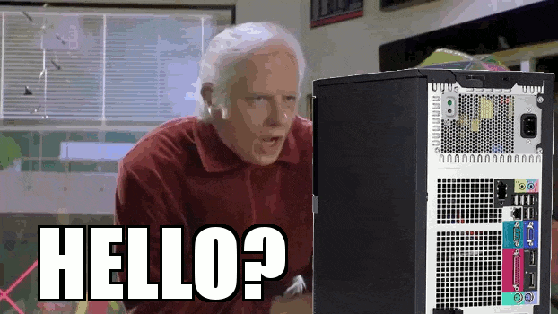
Hardware Only gets you so far
Notes:
Running on virtual machines allowed us to run a lot of tests in parallel but we noticed test execution was not as fast as we expected
There would be times were it would look like the test was frozen and not doing anything
In order to get to the bottom of this we had to fully understand what was going on when we were finding elements on screen

Slide 49
How do we find an element?
Notes:
To interact with a UI element we were searching through every UI element until we found what we want
Elements are organized into something called the visual tree – not just windows application – websites have a similar concept
Visual tree traversal was very slow – WPF applications tend to have complex visual trees
What do I mean when I say visual tree?

Slide 50
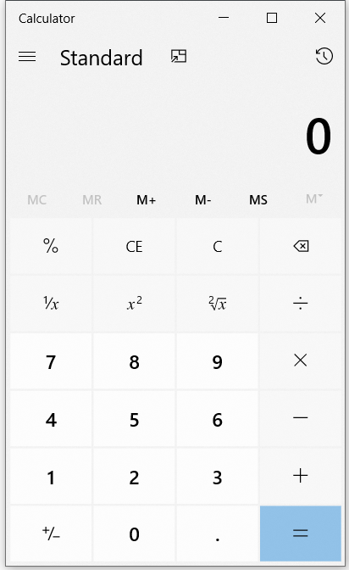
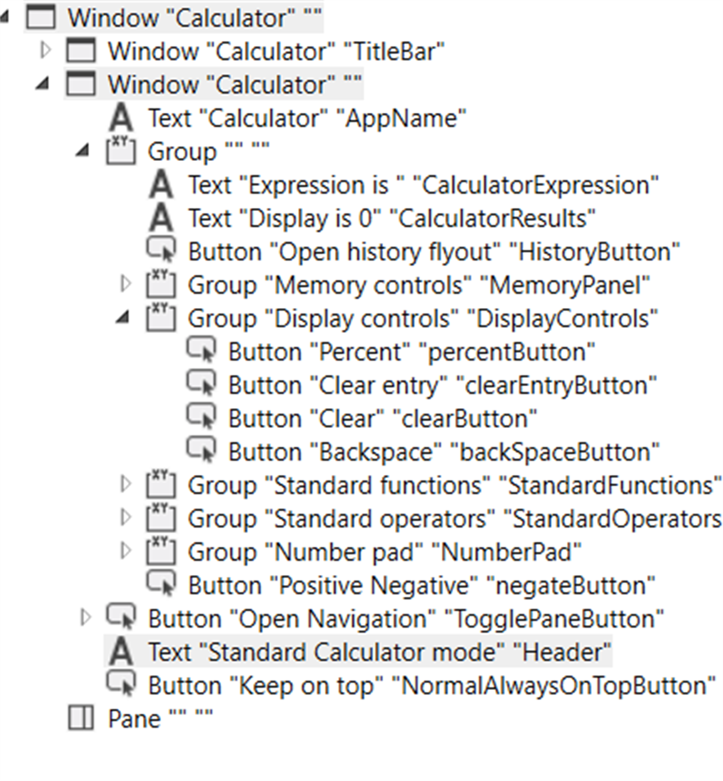
Notes:
Windows calculator, pretty simple application but even this has a complex visual tree
Buttons are organized into groups and these groups can have more groups
Before you know it you have a fairly complex visual tree
So what does it look like when we try and find an element

Slide 51
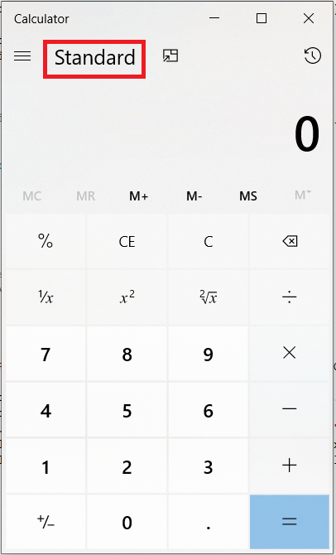
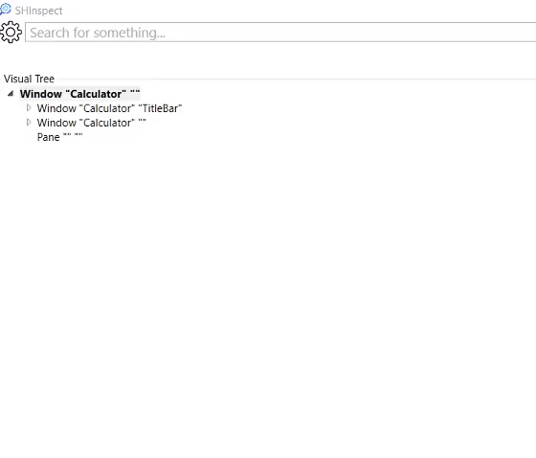
Notes:
Let’s say we wanted to find the calculator mode – in this case set to standard
What would happen? – Press to trigger video
Here we are traversing the tree looking for the mode type text – this isn’t real time, I’ve slowed it down so you can see the process but it’s not far off
See how it searches in each node of the tree before moving onto the next one
Process is slow and very cpu intensive
So let’s have a look at the size of the Compucare visual tree

Slide 52
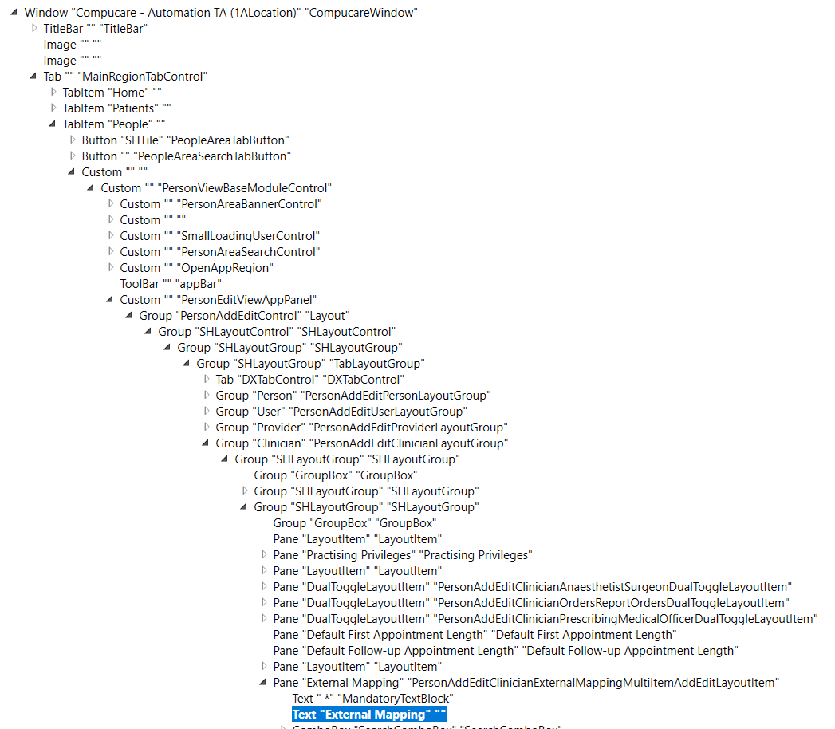
Notes:
Hundreds of controls within hundreds of groups
We needed to speed a way to speed up the traversal process, we knew if we could speed this process up we could get massive performance gains

Slide 53
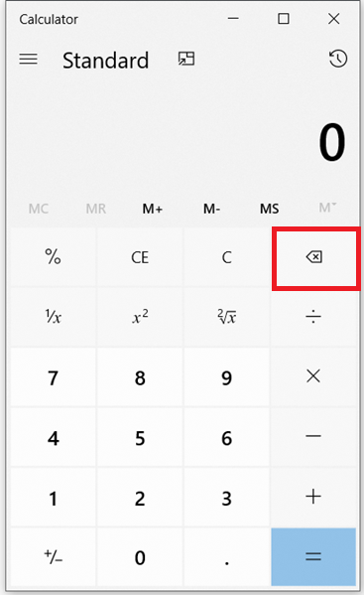

XPATH
/Window[2]/Window[2]/Group/Group[2]/Button[4]
Notes:
Xpaths describe the exact location in the visual tree where the element is
Doesn’t care what the element is, just returns it so you need to know if what returned is what you are after – match on automationid – or a condition
If you know the xpath value you can retrieve the element from the visual tree extremely quickly as no traversal is required
Everytime we retrieve an element from the visual tree we store its xpath value inside Redis – Redis is an in memory key value database mainly used for caching
Next time we search for that element we check the Redis cache first, if it exists we then use the Xpath to retrieve the element – if it doesn’t exist we fall back to visual tree traversal

Slide 54

When things go wrong

Slide 55
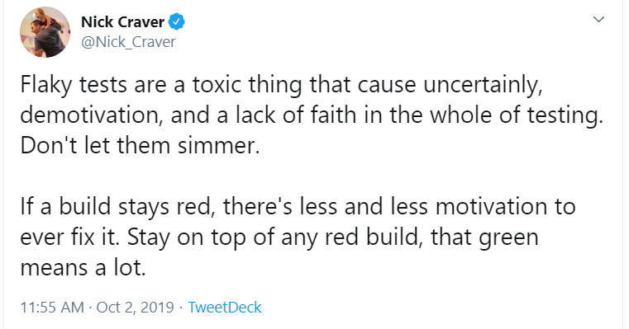
Notes:
Nick is the architecture lead for stack exchange – day job is keeping stack overflow online which I’m sure we are all grateful for
If you don’t follow him on twitter you should
Sums up quite nicely the issue with flaky tests – it’s crucial we have ways to debug them and stop them being flaky

Slide 56
Common failure reasons

Slide 57
Common failure reasons
Screens not being in a state the test expects
Notes:
Screens not being in a state that the tests expect really covers 99% of the reasons tests might fail unexpectedly
Includes screens not loaded before trying to be interacted with, Controls not being in a state that can be interacted with, screens such as grids being mid refresh when the test tried to do something
Not being maximized/windows updates etc

Slide 58
Common failure reasons
Data not being in a state the test expects
Notes:
Every test should only interact with data for that test, if you have tests sharing data then you WILL run into issues – DO NOT DO THIS

Slide 59
Common failure reasons
UI taking longer than expected
Notes:
Links into the first point a little but UIs are not consistent at all, even more so when you have a database running behind them – tests must be able to cater for this

Slide 60
How we know what went wrong
kibana
Bosun
Elasticsearch
logstash
Azure Devops
Notes:
Like I’ve said before, most of what we use is completely open source

Slide 61
How we know what went wrong
kibana
Bosun
Elasticsearch
logstash
Azure Devops
Notes:
Also known as ELK stack to log every action a test does – results in 7 million logs per week
When a test goes wrong we know exactly where it went wrong and what it was doing to the millisecond
Let’s have a quick look at some logs

Slide 62
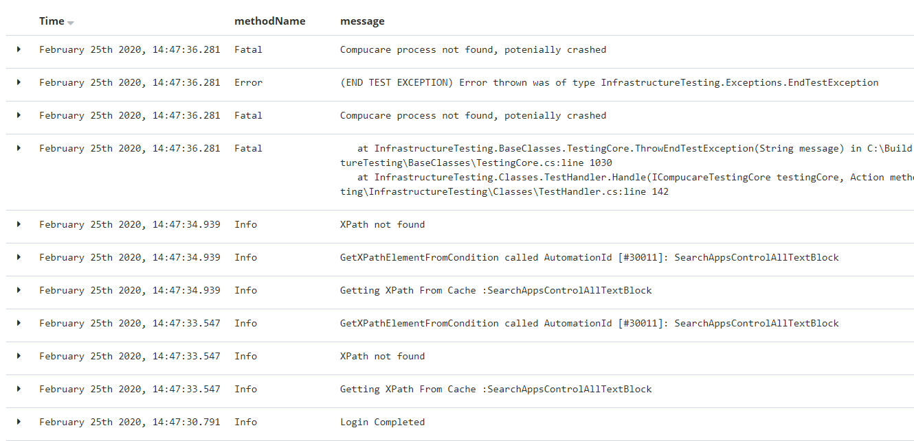
Notes:
Data is logged to the millisecond this allows us to be pretty accurate when analyzing what went wrong
This is an example of a new test running, we get a log when the xpath is not found in the cache so we know its traversing the tree
In this case it looks like the application crashed
We clear this data down each week, we could probably get away with clearing it daily but sometimes its good to analyse logs for a test over a few days

Slide 63
How we know what went wrong
kibana
Bosun
Elasticsearch
logstash
Azure Devops
Notes:
If the test detects an issue it will screenshot the application at that point and upload it to azure devops against the test – without that we’d never know those windows update dialogs have taken focus, this also allows us to see if the application hasn’t finished loaded – those type of things are pretty hard to detect otherwise

Slide 64
How we know what went wrong
kibana
Bosun
Elasticsearch
logstash
Azure Devops
Notes:
Bosun is an alerting and monitoring database developed by stack exchange that runs on top of a time series database – we log the test durations and monitor and alert if we detect is taking longer than its average we can then use the other tools to investigate that’s happened

Slide 65
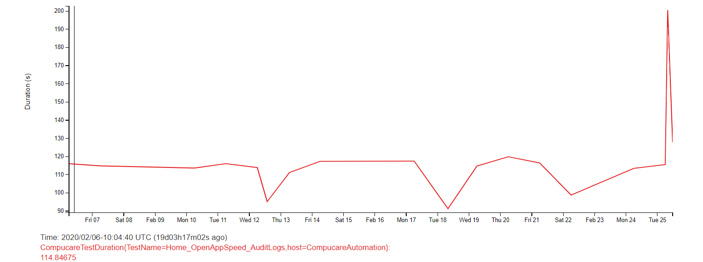
Notes:
This is a Bosun graph from one of our tests showing test run duration
Normally fairly consistent and a peak at the end so we could then investigate

Slide 66
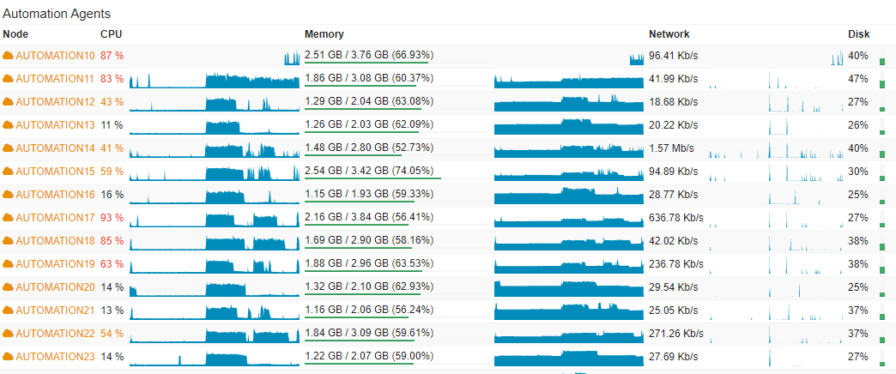
Notes:
We also use Bosun to monitor virtual machine health and alert when we have issues
We never really need to dig into this data but if we did it’s all there
All of these have given us the confidence that if something has gone wrong we can quickly find the root cause and we’re not wasting time trying to debug tests and not getting anywhere

Slide 67
“We don’t really know where this goes – and I’m not sure we really care” - Bob Ross
Notes:
I’ll end on this quote by Bob Ross
Our processes are constantly evolving and we aren’t afraid of trying new things, I’m sure if I give this talk again in a few months the stacks we are using will have completely changed
Hopefully if you are doing UI tests or are thinking about starting then you should now be aware of some of the problems you WILL encounter and how to avoid them
Thanks

Slide 68
Any questions?

